Slide 1

Developing with the Brightcove Native Player SDK for Android
Jeff Doktor
training@brightcove.com

Slide 2
Course Overview
In this course, you will create an app in Android Studio which uses the Brightcove Native Player SDK for Android to
play a video from a remote server
play a video from your Video Cloud library
play a playlist from your Video Cloud library

Slide 3
Course Outline
Introducing the Course
Reviewing Tools and Resources
Understanding the Brightcove Native SDK for Android
Tasks:
Creating a project in Android Studio
Adding the Native SDK for Android
Defining the App Layout
Creating the Video View
Getting a Video from a Remote Server
Getting a Video from your Video Cloud Library
Getting a Playlist from your Video Cloud Library

Slide 4
Introducing the Course

Slide 5
Brightcove Native SDK
What is the Brightcove Native SDK for Android?
A set of libraries built on top of the Android native player framework
Takes advantage of speed, performance and flexibility of the native OS
Integrates with advertising, analytics, captions, content protection (DRM) and Video Cloud
Enables you to configure and play Live and Live DVR content
Includes customizable player controls similar to the Brightcove web player for consistency across desktop and devices

Slide 6
Users and Video Content
Who can use the Brightcove Native SDK for Android?
It is available to anyone with a Video Cloud or Perform account
Where can you play video content from?
Video Cloud customers can play content from their Video Cloud library
Perform customers must play videos from their own servers
This course speaks mostly to Video Cloud customers, but many concepts and code apply to Perform customers. Find Perform-specific code and steps in the Simple Video Playback guide

Slide 7
Audience and Prerequisites
Designed for developers or project managers who want to understand the capabilities of the Native SDK for Android
Experience with Android Studio along with the Java programming language will allow you optimally benefit from this course
Video Cloud account

Slide 8
Reviewing Tools and Resources

Slide 9
Tools
What tools do you need to use the Native SDK for Android?
Android Studio installed on your computer
The official IDE for developing Android apps
Learn more and download Android Studio
Gradle
A dependency manager and build automation tool
Designed for multi-project builds
Already integrated with Android Studio
Learn more about Gradle

Slide 10
Resources
Where do you find resources for the Native SDK for iOS?
Keynote slides can be downloaded from GitHub
Complete code and steps
Video Cloud customers: Android Quick Start guide
Perform customers: Perform Quick Start guide
A collection of code samples demonstrate specific use-cases
Use the SDK forum to submit questions and find answers from the community and Brightcove engineers

Slide 11
Understanding the Brightcove Native Player SDK for Android

Slide 12
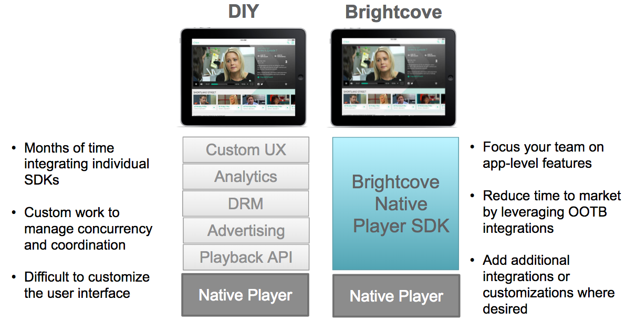
Brightcove Native SDK

Slide 13
The Brightcove Native SDK for Android
A drop-in replacement for Android's VideoView that uses either
Native ExoPlayer
Native MediaPlayer
Allows you to develop using Java in Android Studio
Simplifies creating and customizing a native player
Easily integrates with advertising, analytics, captions, player UI controls, content protection (DRM) and Video Cloud

Slide 14
Creating a Project in Android Studio

Slide 15
Setup an Android Studio Project
Create a new Android Studio project
Set the project information
Application name: Simple-Video-Playback
Company Domain: yourcompany.com
Project location: location on your computer
Select form factors
Select Phone and Tablet
Leave default for Minimum SDK - API 15: Android 4.0.3 (IceCreamSandwich)

Slide 16
Setup an Android Studio Project (cont.)
Add Activity to mobile app
Choose Empty Activity
Provides basic layout for a single Video View
Customize the Activity
Activity Name: MainActivity
Layout Name: activity_main
Select Finish to build the project

Slide 17
Adding the Native SDK for Android

Slide 18
Add the Native SDK for Android
Use Gradle scripts to add the Brightcove Native SDK for Android to your project
In the Gradle Scripts section of your project, open the module build.gradle file
Example:
build.gradle (Module:app)

Slide 19
Add the Native SDK for Android (cont.)
Add the repositories section to point to the Maven repo for the Native SDK
Example:
repositories {
maven {
url 'http://repo.brightcove.com/releases'
}
}

Slide 20
Add the Native SDK for Android (cont.)
In the dependencies section, include the Native SDK
Example:
compile "com.brightcove.player:exoplayer:4.+"
Build the project

Slide 21
Defining the App Layout

Slide 22
Define the App Layout
Open the activity_main.xml file
Remove the existing TextView section
Add a BrightcoveExoPlayerVideoView section
Learn more about the BrightcoveExoPlayerVideoView class

Slide 23
Define the App Layout (cont.)
Example:
<com.brightcove.player.view.BrightcoveExoPlayerVideoView
android:id="@+id/brightcove_video_view"
android:layout_width="match_parent"
android:layout_height="280dp"
android:layout_gravity="center_horizontal|top"/>

Slide 24
Enable the App for the Internet
Open the AndroidManifest.xml file
Add a uses-permission element for the internet
Example:
<uses-permission android:name="android.permission.INTERNET"/>

Slide 25
Creating the Video View

Slide 26
Extend the BrightcovePlayer class
Open the MainActivity.java file
For the MainActivity class, extend the BrightcovePlayer class
Provides default lifecycle management for your app
For an overview, see the Understanding BrightcovePlayer document
Learn more about the BrightcovePlayer class
Example:
public class MainActivity extends BrightcovePlayer {}

Slide 27
Create the Video View
Create an instance variable for the Video View
Refer to the Choosing a Video View document
In most cases, use the BrightcoveExoPlayerVideoView
Example:
brightcoveVideoView = (BrightcoveExoPlayerVideoView) findViewById(R.id.brightcove_video_view);

Slide 28
Register Your App
Send your Account Id to Video Cloud Analytics
This is optional, and only needed if do either
Override the BrightcoveExoPlayerVideoView class
Do not get your video content from Brightcove's Playback API or Media API
Perform customers with remote assets need to send your Account Id to Analytics
For details, see the Using Brightcove Analytics document

Slide 29
Register Your App (cont.)
Example:
Analytics analytics = brightcoveVideoView.getAnalytics();
analytics.setAccount(<your account id>);

Slide 30
Getting a Video from a Remote Server

Slide 31
Get a Video from a Remote Server
Required for Perform customers
Add a Video View from a remote server
Start video playback
Example:
brightcoveVideoView.add(Video.createVideo("http://solutions.brightcove.com/bcls/assets/videos/Tiger.m3u8", DeliveryType.HLS));
brightcoveVideoView.start();

Slide 32
Run the app
The app is ready to build and run on your device or within the Android Studio Emulator
Learn more about running apps in the Android emulator
You should see a video play from your remote server

Slide 33
Getting a Video from your Video Cloud Library

Slide 34
Customize the project with your values
Add the following values
Your Brightcove Playback API Policy Key
Either get the Policy Key from a player in your account as shown in the Policy Keys guide
Or create a Policy Key by following the steps in the Quick Start to the Policy API document
Your Video Cloud Account Id
Your Video Cloud Video Id

Slide 35
Define Variables
Get the SDK eventEmitter for the View
Used to emit and listen to player events
For an overview, see the Understanding Events document
Example:
EventEmitter eventEmitter = brightcoveVideoView.getEventEmitter();

Slide 36
Define Variables (cont.)
Create an instance of com.brightcove.player.edge.Catalog using the event emitter along with your Video Cloud Account Id and Policy Key
This class provides asynchronous methods for retrieving data from the Playback API
Example:
Catalog catalog = new Catalog(eventEmitter, getString(R.string.account), getString(R.string.policy));

Slide 37
Retrieve a Video from your Video Cloud Library
Retrieve a video from the Playback API
Use findVideoByID()
Or findVideoByReferenceID()
Example:
catalog.findVideoByID(getString(R.string.videoId), new VideoListener() { }
If a video is returned, add it to the player
Otherwise, display an error message

Slide 38
Getting a Playlist from your Video Cloud Library

Slide 39
Customize the project with your values
Add the following values
Your Brightcove Playback API Policy Key
Details about the Policy Key were discussed in the previous section of the course
Your Video Cloud Account Id
Your Video Cloud Playlist Id

Slide 40
Retrieve a Playlist from your Video Cloud Library
Retrieve a playlist from the Playback API
Use findPlaylistByID()
Or findPlaylistByReferenceID()
Example:
catalog.findPlaylistByID(getString(R.string.playlistId),
new PlaylistListener() { }
If a playlist is returned, add it to the player
Otherwise, display an error message

Slide 41
Additional Resources

Slide 42
Samples using the Native Player SDK for Android
Basic code samples for feature integration
http://docs.brightcove.com/en/video-cloud/mobile-sdks/brightcove-player-sdk-for-android/index.html#Integrations
Complete list of code samples
https://github.com/BrightcoveOS/android-player-samples

Slide 43
Online Training and Quick Start Guide
Video Cloud Training On-Demand Courses
http://ondemand.brightcovelearning.com
Quick Start to Video Cloud
Set of hands on steps you can work through on your own to discover some of the features of Video Cloud
http://support.brightcove.com/en/video-cloud/docs/quick-start-video-cloud

Slide 44
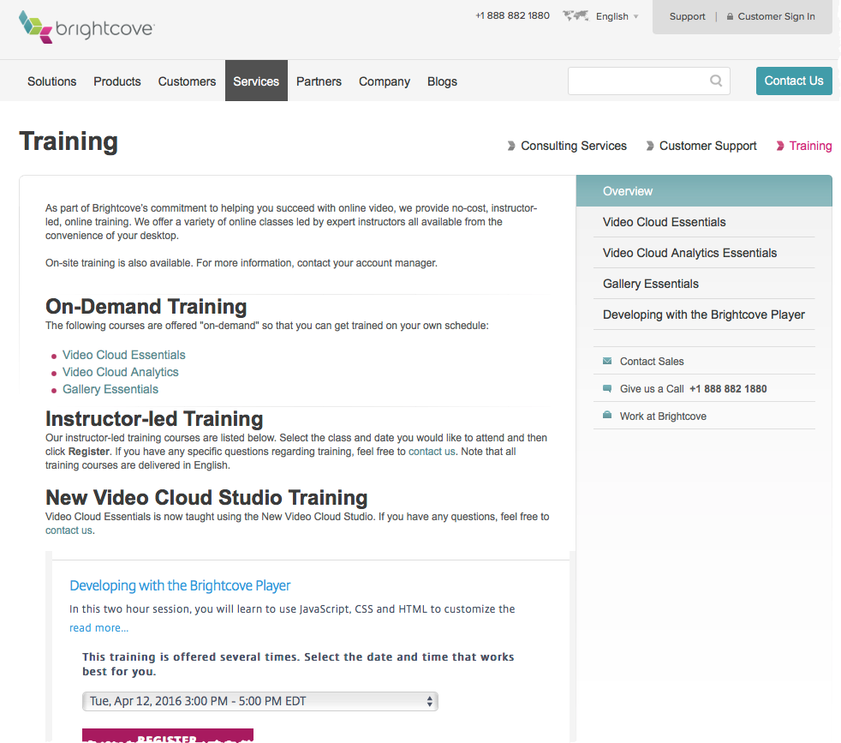
Additional Training Courses
Brightcove.com > Services > Training

Slide 45
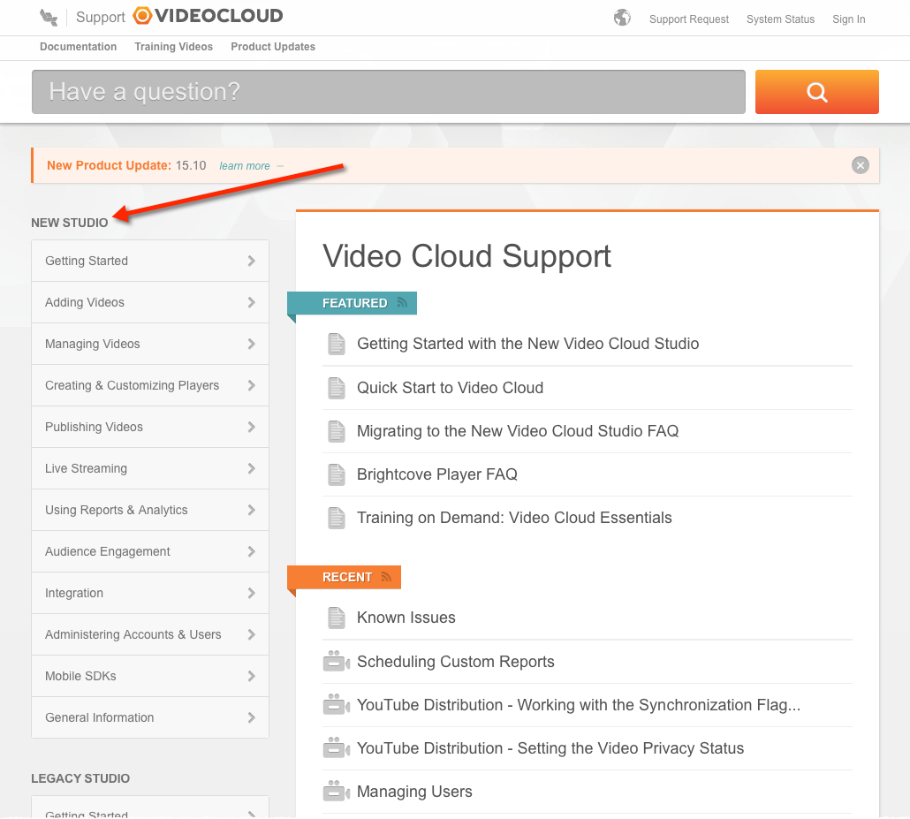
User Documentation
support.brightcove.com

Slide 46
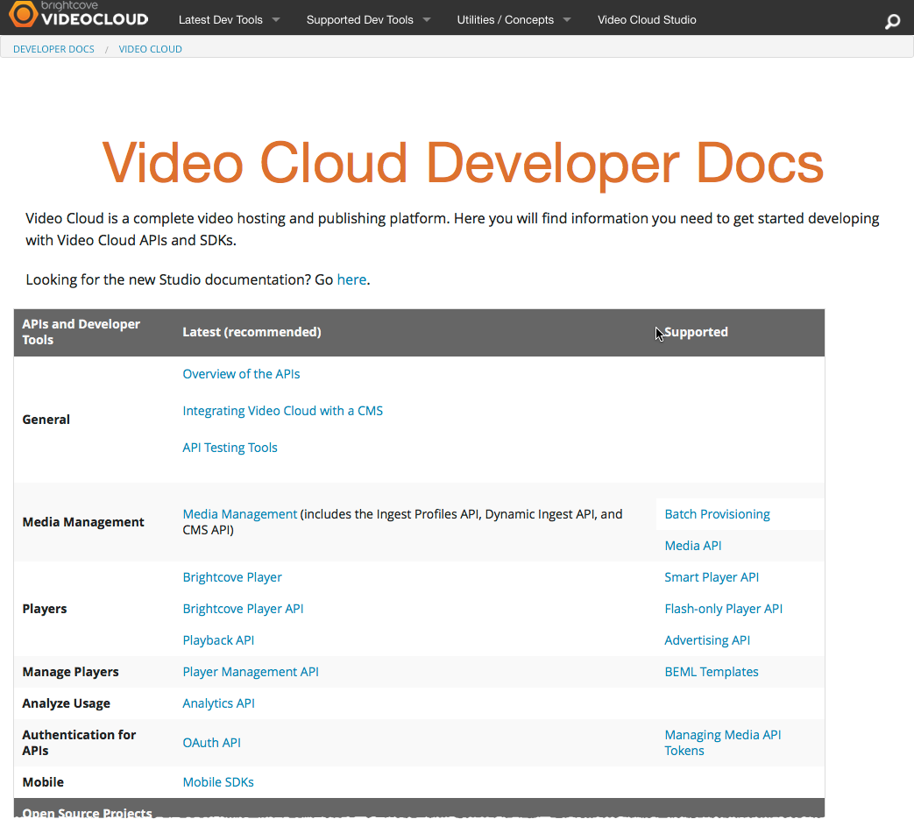
Developer Documentation
docs.brightcove.com

Slide 47
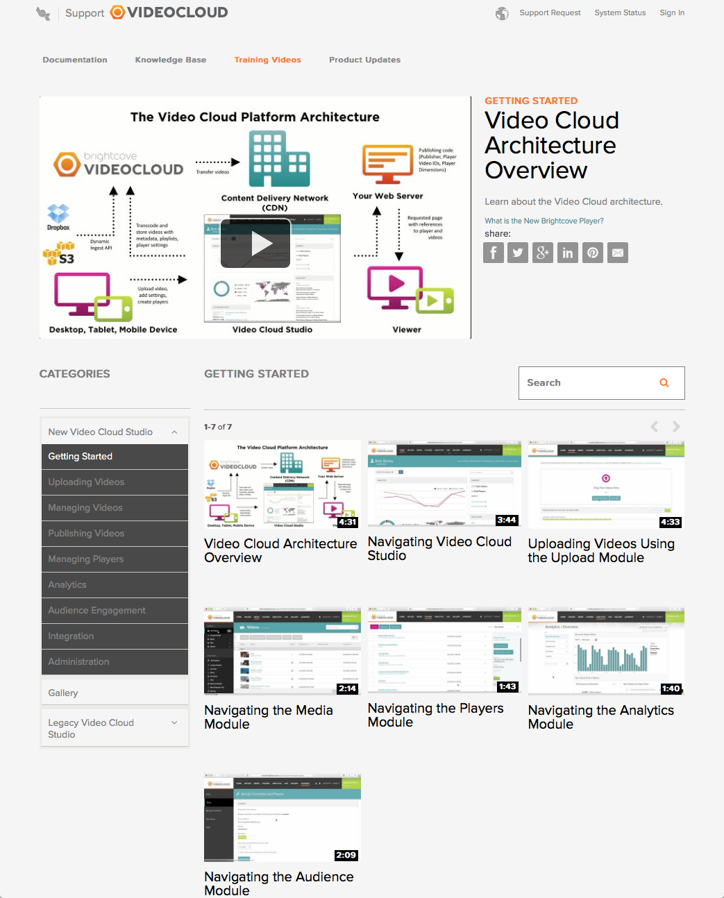
Training Videos
video.brightcovelearning.com

Slide 48
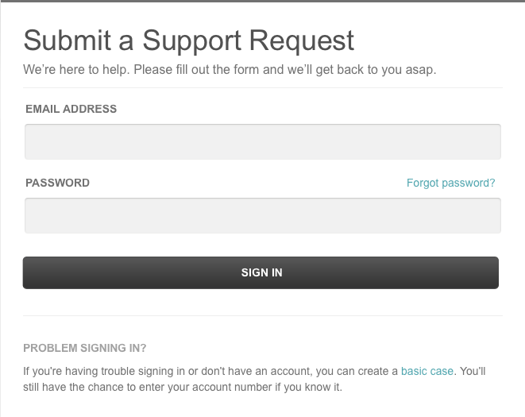
Support Request
http://support.brightcove.com/en/contact

